Slide 1
Lipids, Structure and Properties

Slide 2
Quiz Question 1
Which lipid is essential in the human diet
Cholesterol
Linoleate
Palmitate
Oleate
Notes:
B

Slide 3
Quiz Question 2
For polyunsaturated fatty acids how far along the chain are subsequent double bonds relative to the bond preceeding it
Double bonds are generally adjacent
Double bonds are generally two carbons farther along
Double bonds are generally three carbons farther along
Double bonds are generally four carbons farther along

Slide 4
Quiz Question 3
What does amphipathic mean?
A lipid has a hydrophilic and hydrophobic part
A fatty acid has multiple double bonds
Two different acyl chains are added to a glycerol head group
The lipid can sense what you are feeling right now

Slide 5
Learning Objectives
Understand the different roles of lipids in our bodies
Describe the structure and functions of fatty acids
Understand the nomenclature of fatty acids
Identify the subclasses of lipids in which fatty acids are constituents of
Describe the structure and functions of triacylglycerols (triglycerides)
Describe the structure and functions of cholesterol
Recognize that phospholipids are amphipathic and play an important role as structural components within our body

Slide 6
Roles of lipids
Lipids have many functions in body
Structural and functional components of cells
Inflammatory response
Hormone production
Energy source
Insulation
Recommendations: 20-35% of energy intake per day (IOM Guidelines 2010)

Slide 7
Types of Lipids
Triglycerides
Phospholipids
Sterols

Slide 8
Structure of Sterols
Cholesterol
Fatty Acid Ester
(in this case oleic acid)
Cholesterol Ester

Slide 9
Role of cholesterol in cells
Component of cell membranes, enhances membrane fluidity
Pre-cursor to many bodily compounds
Bile salts
Hormones: estrogen, androgen, progesterone
Vitamin D
Not essential, can be made by cells

Slide 10
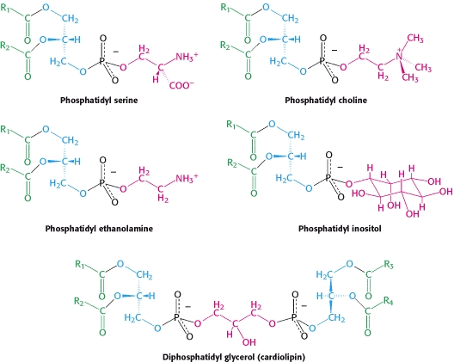
Structure of Phospholipids
Notes:
Head groups matter!

Slide 11
Phospholipids as amphipathic barriers
Notes:
Point out that this is phosphatidylcholine

Slide 12
Choline Deficiency
A major phospholipid is phosphatidylcholine
Choline is a micronutrient used for methylation reactions
Humans can (barely) make it, so it is essential, also important during pregnancy.
High levels in eggs, beef liver, wheat germ and meats so vegetarians can be at risk of choline deficiency
Deficiency can result in:
Developmental defects
NAFLD
Anxiety
Notes:
90% of people on earth are “choline deficient”
Classified as essential nutrient in 1998

Slide 13
Nutrigenomics and choline
Subjects were randomized into choline deficient diets
Monitored for signs of deficiency
Liver fat
Muscle breakdown
Variants in single-nucleotide polymorphisms of PEMT associated with responses to choline deficiency (OR: 25 in women)
28% of the population have this allele
da Costa K-A, Kozyreva OG, Song J, Galanko J A, Fischer LM, Zeisel SH. Common genetic polymorphisms affect the human requirement for the nutrient choline. FASEB J 2006; 20:1336–44.

Slide 14
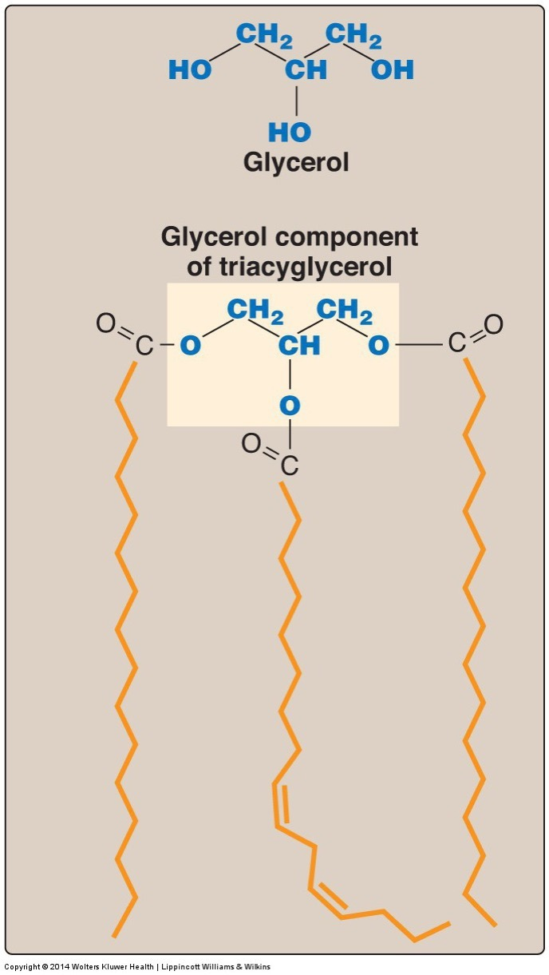
Structure of Triglycerides
95% of human fat
Largest energy store in the body
Glycerol backbone with three acyl groups
Stored with cholesterol in lipid droplets

Slide 15
Fatty Acid Nomenclature

Slide 16
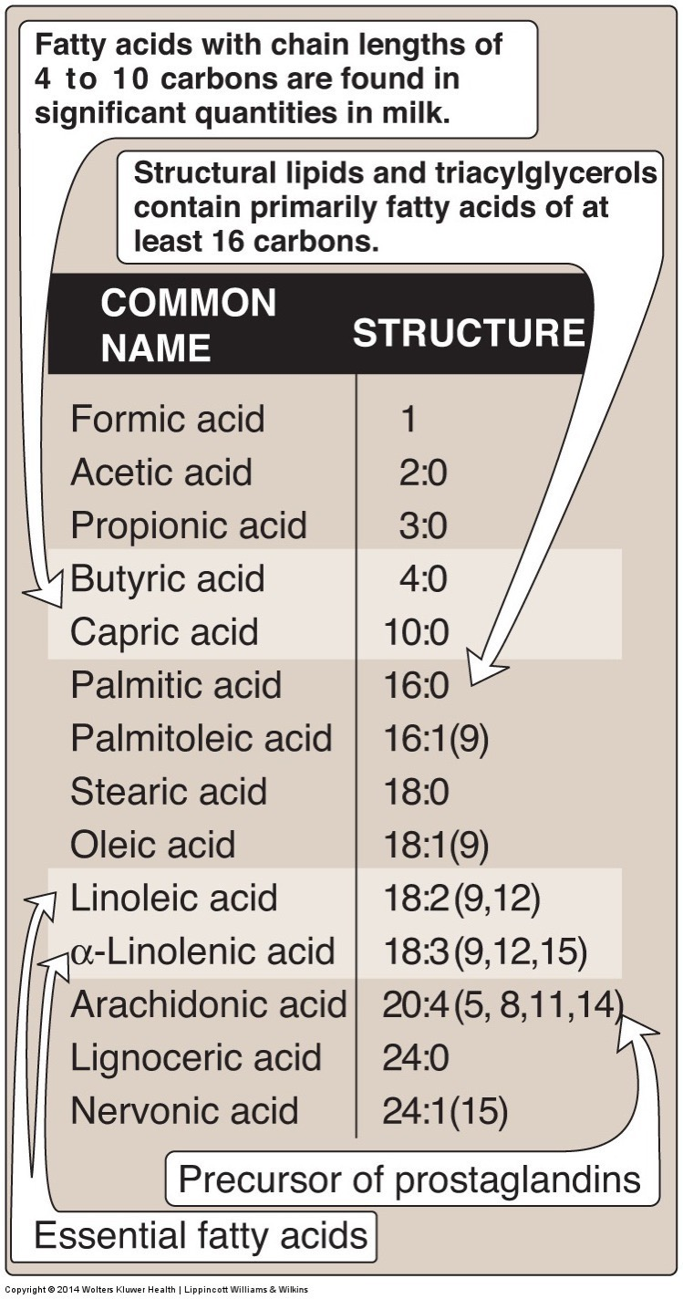
Fatty Acid Classification
Classification based on length
Short Chain < 6
Medium Chain 6-12
Long Chain 12-21
Very Long Chain 22+
Classification based on saturation (double bonds)
Saturated Fatty Acids
Monounsaturated Fatty Acids
Polyunsaturated Fatty Acids

Slide 17
Short Chain Fatty Acids are Derived in Gut
Derived from fiber
Will discuss this and the role of the microbiome in digestion in a few lectures

Slide 18
Medium Chain Fatty Acids
Shorter therefore more easily metabolized than long chain fatty acids
High in palm kernel and coconut oil
Generally saturated
Metabolized by intestinal cells and go straight to liver
Will discuss this in lecture on digestion

Slide 19
Saturated and Unsaturated Fatty Acids
Saturated Fatty Acids
Monounsaturated Fatty Acids (MUFA)
Polyunsaturated Fatty Acids (PUFA)

Slide 20
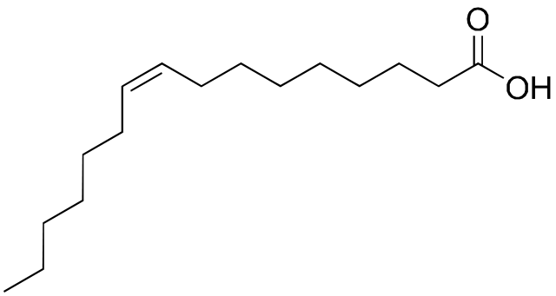
Nomenclature of Unsaturated Fatty Acids
Several naming systems
Common name (Palmitate, Linoleate, etc)
Delta nomenclature
Δ indicates double bond location (from acid end)
n-x or ω nomenclature
Indicates double bond location (from methyl end)
Lipid numbers
N:D where:
N is the length of the chain
D is the number of double bonds
Ambiguous so often combined with Delta/ n-x or ω
Naming Type | Example
Common Name | Palmitoleic Acid
Delta | cis-Δ⁹-Hexadecenoic acid
n-x/ω | ω7 – Hexadecenoicacid
Lipid numbers | 16:1 or 16:1 ω7

Slide 21
Naming Practice – Oleic Acid

Slide 22
Naming Practice – Draw These (all cis)
Myristic acid 18:0
Palmitoleic acid 16:1 cis-Δ⁹
Docosahexaenoic acid 22:6(n-3)
Multiple desaturations separated by one carbon with single bonds on either side (3 numbers)
Elaidic acid 18:1 trans-Δ⁹
Notes:
For multiple bonds, they start at omega end, and go back every third

Slide 23
Cis and Trans Fats
Most occurring fatty acids are cis
Trans fats are made industrially
Can make fats solid from easily available liquid fat (vegetable oils) via partial hydrogenation
Looks more like a saturated fat

Slide 24
Health Problems Associated with Trans Fatty Acids
Increases in risk factors for cardiovascular disease
Raised LDL, cholesterol, lowered HDL
Raised triglycerides
Increased inflammation and impaired endothelial cell function
Obesity
de Souza RJ, Mente A, Maroleanu A, Cozma AI, Ha V, Kishibe T, Uleryk E, Budylowski P, Schünemann H, Beyene J, et al. Intake of saturated and trans unsaturated fatty acids and risk of all cause mortality, cardiovascular disease, and type 2 diabetes: systematic review and meta-analysis of observational studies. BMJ 2015; 351:h3978.
Notes:
Mechanism currently unknown

Slide 25
Trans fat consumption

Slide 26
Replacing trans fats with palm oil
Grows in tropics, solid at Room Temperature
44% Palmitate 16:0
38% Oleate 18:1ω9
Why is palm but not olive oil solid at room temperature?
More saturated fats
Less saturated fats
Longer chain length
Shorter chain length
Compare with:
Butter
31% Palmitate 16:0
24% Oleate 18:1ω9
12% Myristate 14:0
11% Stearate 18:0
Olive oil
71% Oleate 18:1ω9
11% Palmitoleate 18:2ω7
11% Palmitate 16:0

Slide 27
Fatty Acids in Some Common Fats
Notes:
Point out the effects of hydrogenation of cottonseet oil

Slide 28
Why might coconut oil (mostly saturated fat) be semi-liquid at room temperature?

Slide 29
Desaturases and Double Bond Formation
SCD1
NOT IN HUMANS

Slide 30
Studies on “Vitamin F”
Burr M, Miller S. Fatty Acids in Nutrition. J Biol Chem 1932; 97:1–9.

Slide 31
ω3 and ω6 Fatty Acids are Essential in Humans
We have desaturates, but not any ω3 and ω6 desaturases
Because of this, we cannot convert 18:0 into 18:2ω6 or 18:3ω3
These PUFAs are required for several signaling lipids and must be obtained from the diet.
From plant sources
Linoleic acid (18:2 ω-6) Alpha-linolenic acid (18:3 ω-3)
From fish oils
EPA and DHA
Notes:
Formerly called vitamin F

Slide 32
ω3 and ω6 Fatty Acid Ratio
ω3 are thought to be metabolically beneficial
ω6 are essential but are generally over-consumed relative to ω3
In western diets can be 15:1
They compete with each other for enzymes, which is thought to be why too much ω6 can cause ω3 pseudo-deficiency

Slide 33
Learning Objectives
Understand the different roles of lipids in our bodies
Describe the structure and functions of fatty acids
Understand the nomenclature of fatty acids
Identify the subclasses of lipids in which fatty acids are constituents of
Describe the structure and functions of triacylglycerols (triglycerides)
Describe the structure and functions of cholesterol
Recognize that phospholipids are amphipathic and play an important role as structural components within our body

